Slide 1



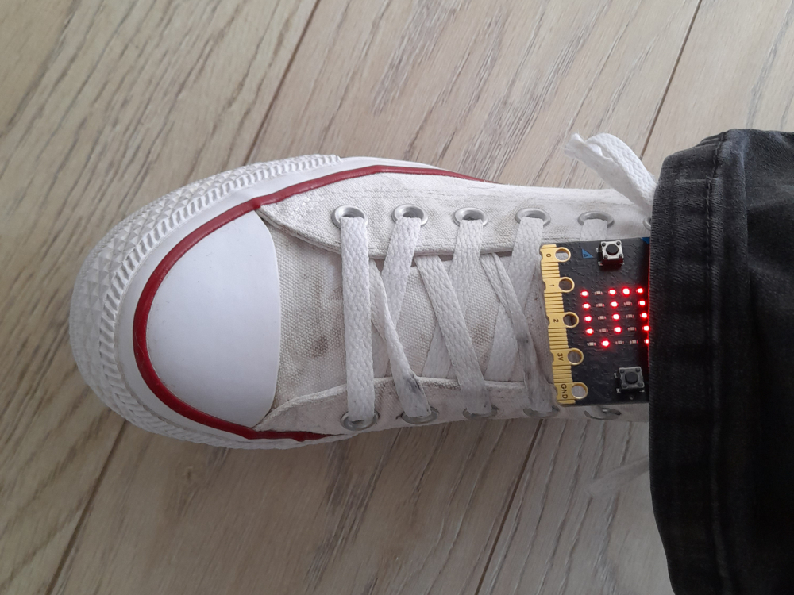


Lesson 4 Step counter

Slide 2
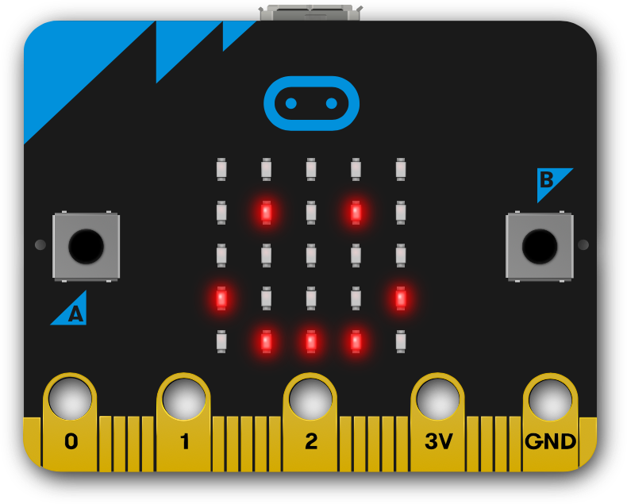

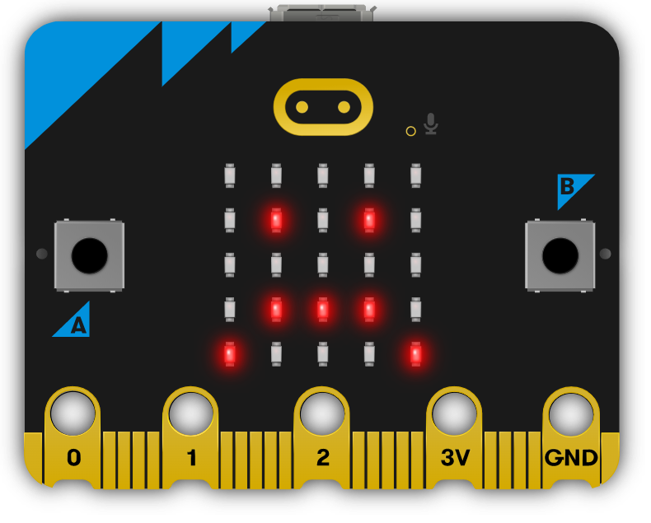
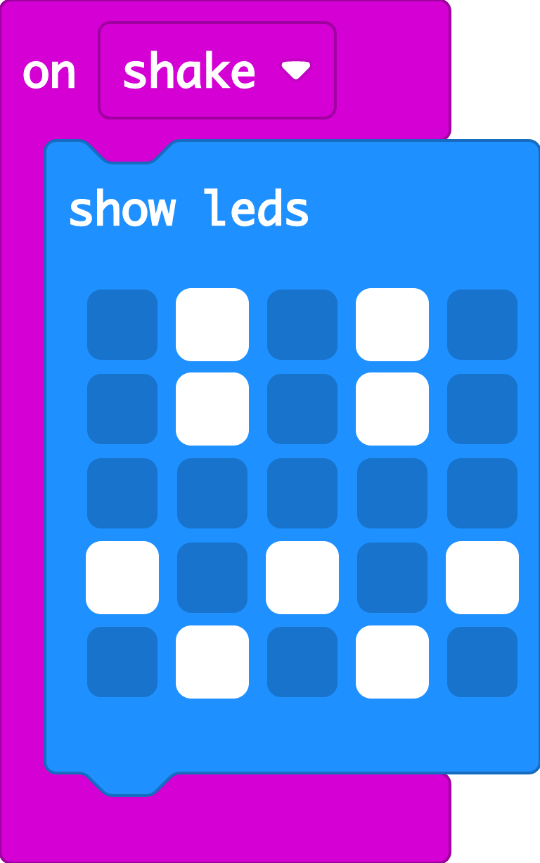

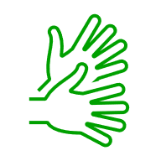
Recap: emotion badge
Last time we used different button inputs to show different emotions on the micro:bit’s LED display output.
You may also have used the ‘on shake’ block to show other emotion images when you shake your micro:bit.
The micro:bit’s accelerometer senses when it’s shaken. We’ll be using it today.

Slide 3

Introducing the accelerometer
Notes:
We’ll be making a Rock, paper, scissors game using the accelerometer in lesson six in this series.

Slide 4





Think: learning objectives
I can turn my micro:bit into a step counter using the accelerometer and variables.
I can explain that the accelerometer is a sensor, an input that senses movement.
I can explain that variables are containers for storing data which can be accessed and updated.
Notes:
Explain that the accelerometer is a sensor input that senses when you shake your micro:bit.
Students may have already used accelerometers to count steps using phones, watches or fitness trackers.
The accelerometer is labelled on the back of the micro:bit, so you can see where it is – even though it’s tiny, it contains moving parts that react to movement. Variables help us count how many steps we’ve taken. They are containers for storing data which can be accessed and updated while a program is running.

Slide 5
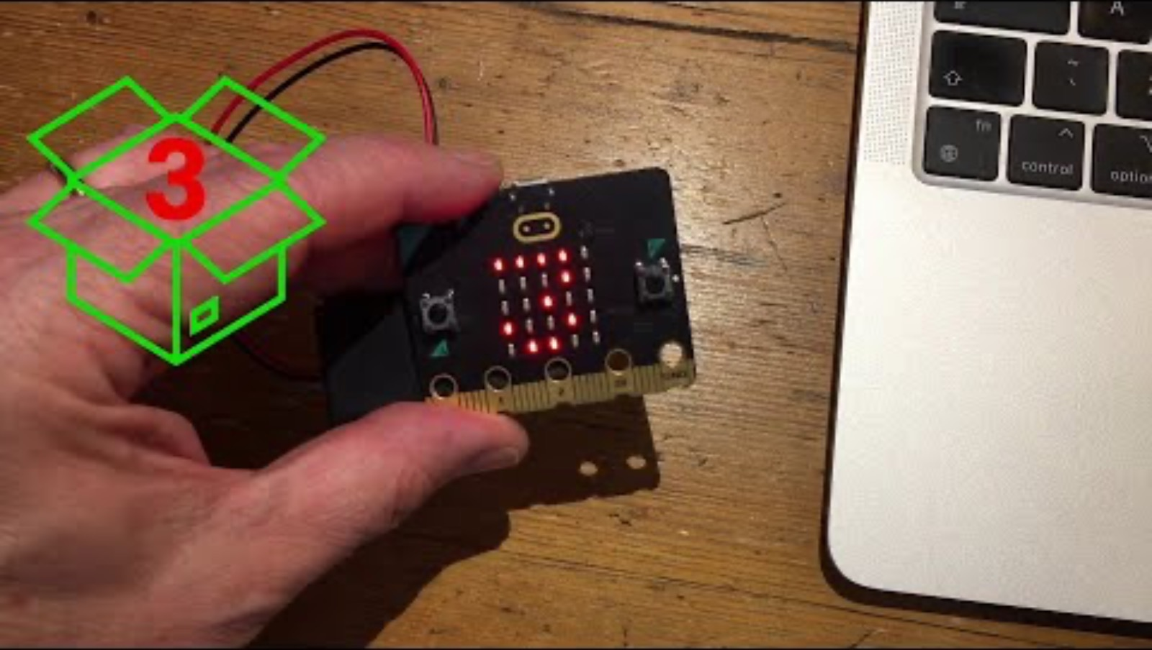


Think: step counter introduction video
Optionally play video: https://youtu.be/bSANf_njTSk

Slide 6

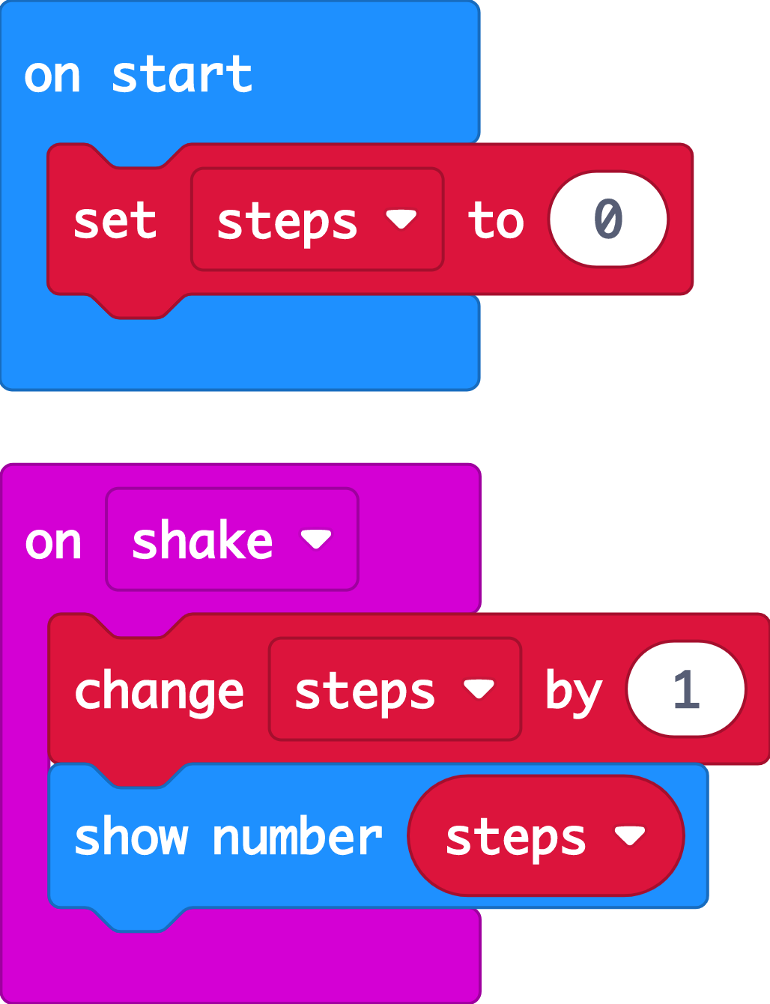

Create: examine the code
At the start the code sets a variable called ‘steps’ to 0.
The ‘steps’ variable keeps track of how many steps we’ve taken.
When the accelerometer input senses a shake, the ‘change’ block adds 1 to the number stored in the ‘steps’ variable.
After the ‘steps’ variable is updated, ‘show number’ displays the new count on the LED display output.
Teacher: open the completed code in the editor
Notes:
You can follow the link to open the completed code in the editor.
It’s a good idea to set variables to a known value at the start of a computer program.
The order of blocks is important – the code must show the ‘steps’ variable number on the LED display after it’s been updated, or the count will be out-of-date!

Slide 7

Create: build the code
Open a new MakeCode project https://makecode.microbit.org/
Notes:
You can follow the link to open a new MakeCode project and model building the code yourself – or use slide 8 to show a YouTube coding video, or slide 9 to show an animated GIF of building the code if YouTube is blocked in your school.

Slide 8

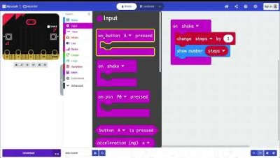
Create: coding video
YouTube coding video: https://mbit.io/lessons-step-code-video
Notes:
Optionally share this YouTube coding video with your class: https://mbit.io/lessons-step-code-video

Slide 9


Create: coding animation
Notes:
Animated GIF of building the code you can share with your students, if YouTube is blocked in your school.

Slide 10
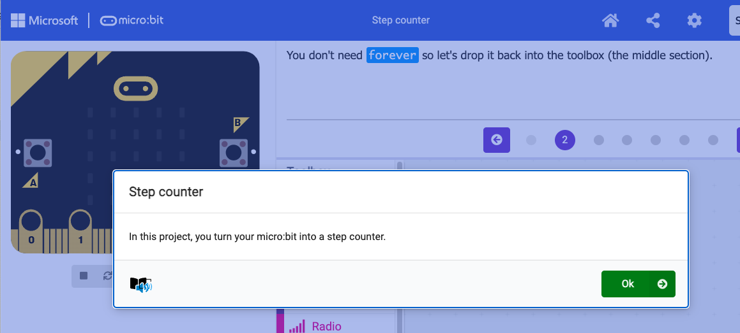
Create: step-by-step online tutorial
https://mbit.io/tutorial-step-counter
Notes:
You can optionally share this online step-by-step tutorial with your students to follow individually.

Slide 11




Evaluate
Download your code to a micro:bit
Does it work as you expect?
How good is the project?
Could it have other uses?
How does it work?
Notes:
Does it work as you expect?
If not, do you need to debug the code and download it again?
How good is the project?
Can you think of anyone who would like this project and find it useful of enjoyable?
How could you improve it?
Students may find the display hard to read, that they have to stamp their legs to record steps, or that it counts fewer steps than they expected. See ‘Extend’ below for some ideas for improving the project.
Could it have other uses?
How does it work?
Encourage students to think about how it works when using it.

Slide 12

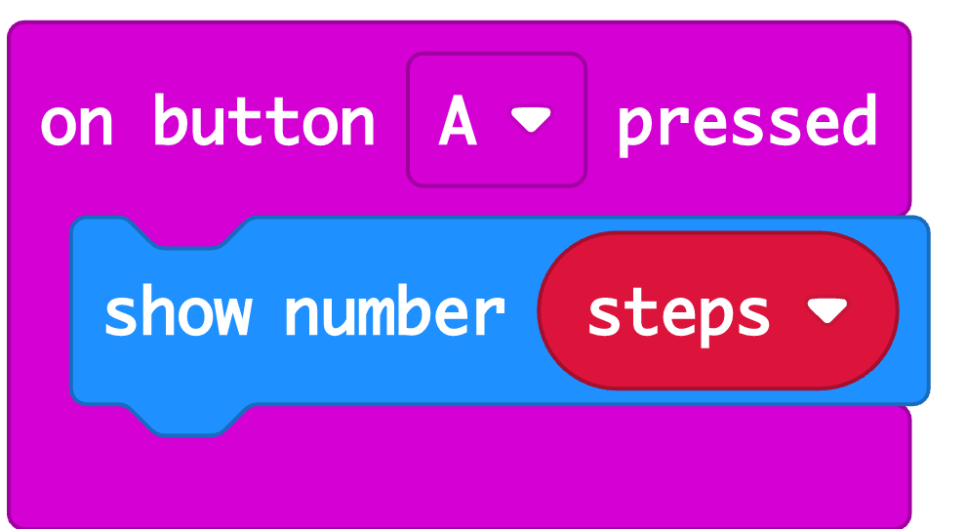

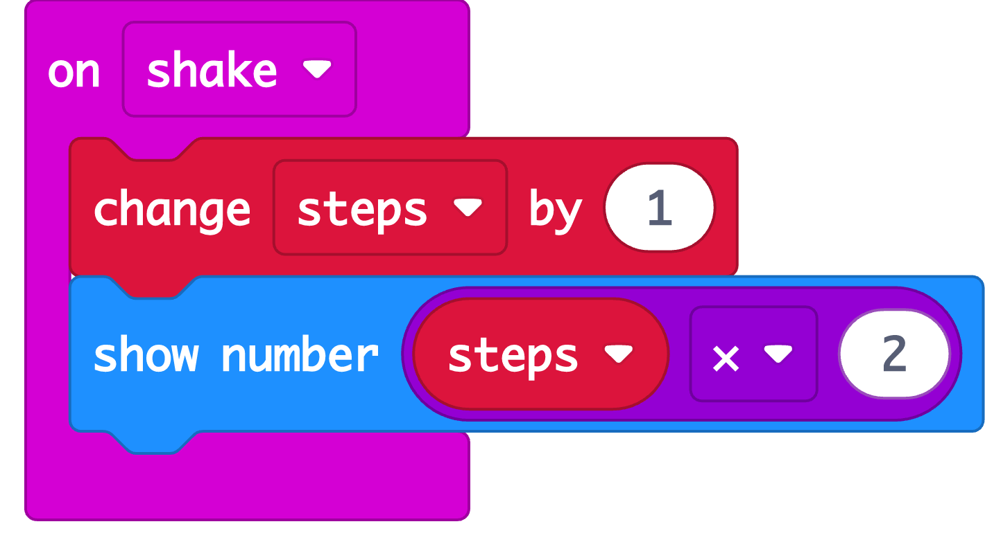

Extend
Add blocks to show the step count when you press button A.
If it’s counting too few steps, modify the code using Maths blocks to fix this.
Notes:
Add an ‘on button A pressed’ block to show the step count when you press button A – this means you can read the step count at any time without having to shake the micro:bit.
Assess how accurate your step counter is. If the step counter is attached to one leg, it may be counting strides rather than steps, counting every other step. Students could compensate for this by using Maths blocks to multiply the ‘step’ variable by 2 when it’s shown on the LED display.

Slide 13

Share: revisit the learning objectives
I can turn my micro:bit into a step counter using the accelerometer and variables.
I can explain that variables are containers for storing data which can be accessed and updated.
I can explain that the accelerometer is a sensor, an input that senses movement.
Notes:
Ask:
How does your step counter work? How accurate is it? (This will vary. It could depend on where or how micro:bits were attached. Students may also discover that the step counter counts every other step, or how many strides they took, rather than steps.)
How could you improve it? (e.g. multiply the step count by 2, add a button press to show the step count)
Why do we use variables in the code? (So the micro:bit keeps track of how many steps we took.)
What job does the accelerometer do in a step counter? (It senses movement)

Slide 14

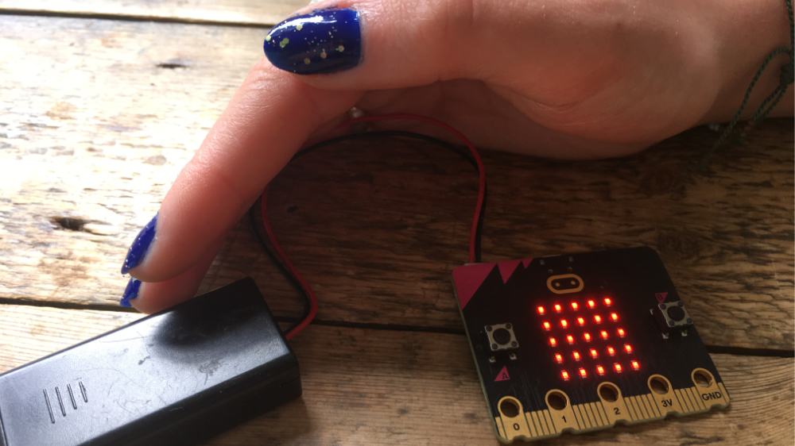
Next steps
Today we used the accelerometer sensor input that can sense when you shake your micro:bit to make a step counter.
Next time, we’re going to use another micro:bit sensor and logic to turn LED lights on automatically when it gets dark.

